Slide 1

Valuing Software and Other Research Outputs
Daniel S. Katz
dkatz@nsf.gov & d.katz@ieee.org
@danielskatz
Program Director, Division of Advanced Cyberinfrastructure
1am:London – The Altmetrics Conference
26 September 2014

Slide 2
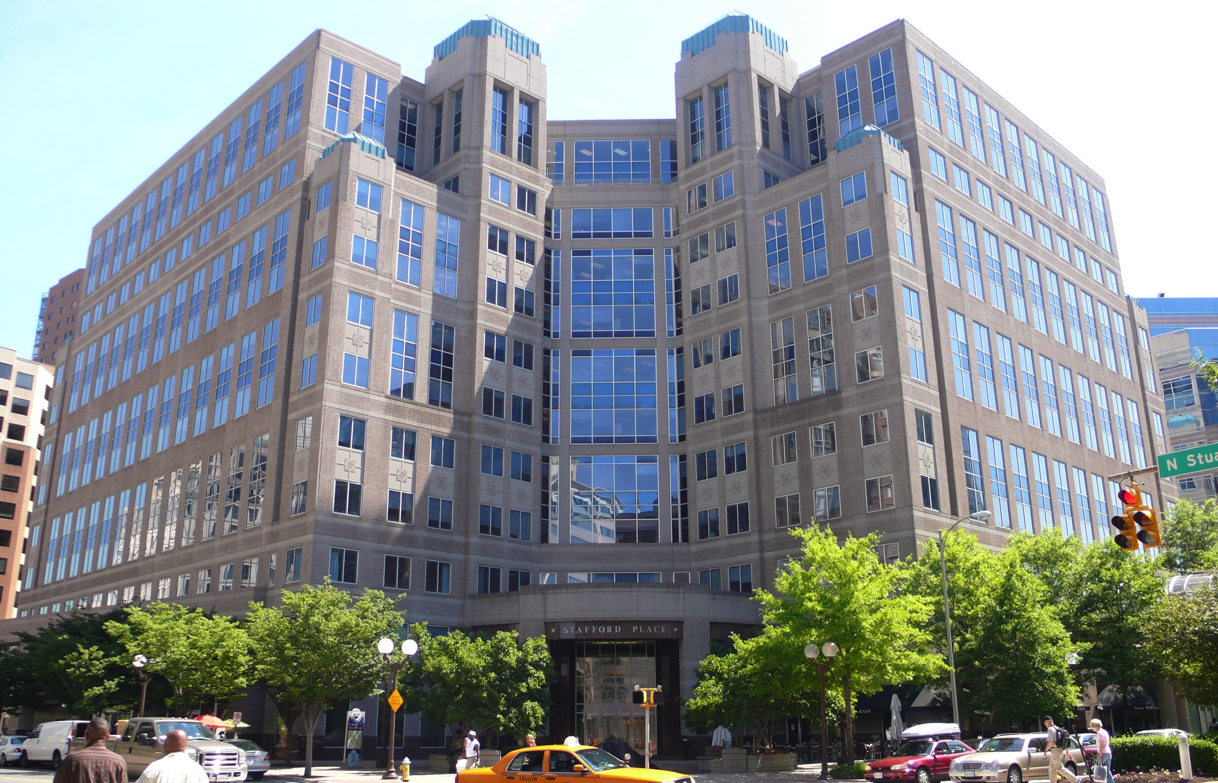
National Science Foundation
Federal agency created in 1950 "to promote the progress of science; to advance the national health, prosperity, and welfare; to secure the national defense…”
Annual budget of $7.2 billion (FY 2014)
Funds 24 percent of all federally supported basic research at US colleges and universities
In many fields such as mathematics, computer science and the social sciences, NSF is the major source of federal funds

Slide 3
NSF

Slide 4
Advanced Cyberinfrastructure (ACI) Division
Supports and coordinates the development, acquisition, and provision of state-of-the-art cyberinfrastructure resources, tools, and services
Supports forward-looking research and education to expand the future capabilities of cyberinfrastructure
Serves the growing community of scientists and engineers, across all disciplines, whose work relies on the power of advanced computation, data-handling, and networking

Slide 5
Cyberinfrastructure
“Cyberinfrastructure consists of
computing systems,
data storage systems,
advanced instruments and
data repositories,
visualization environments, and
people,
all linked together by
software and
high performance networks,
to improve research productivity and
enable breakthroughs not otherwise possible.”
-- Craig Stewart

Slide 6

Software as Infrastructure
Science
Software (including services) essential for the bulk of science
About half the papers in recent issues of Science were software-intensive projects
Research becoming dependent upon advances in software
Significant software development being conducted across NSF: NEON, OOI, NEES, NCN, iPlant, etc
Wide range of software types: system, applications, modeling, gateways, analysis, algorithms, middleware, libraries
Software is not a one-time effort, it must be sustained
Development, production, and maintenance are people intensive
Software life-times are long vs hardware
Software has under-appreciated value
Software
Computing Infrastructure
For software to be sustainable, it must become infrastructure

Slide 7
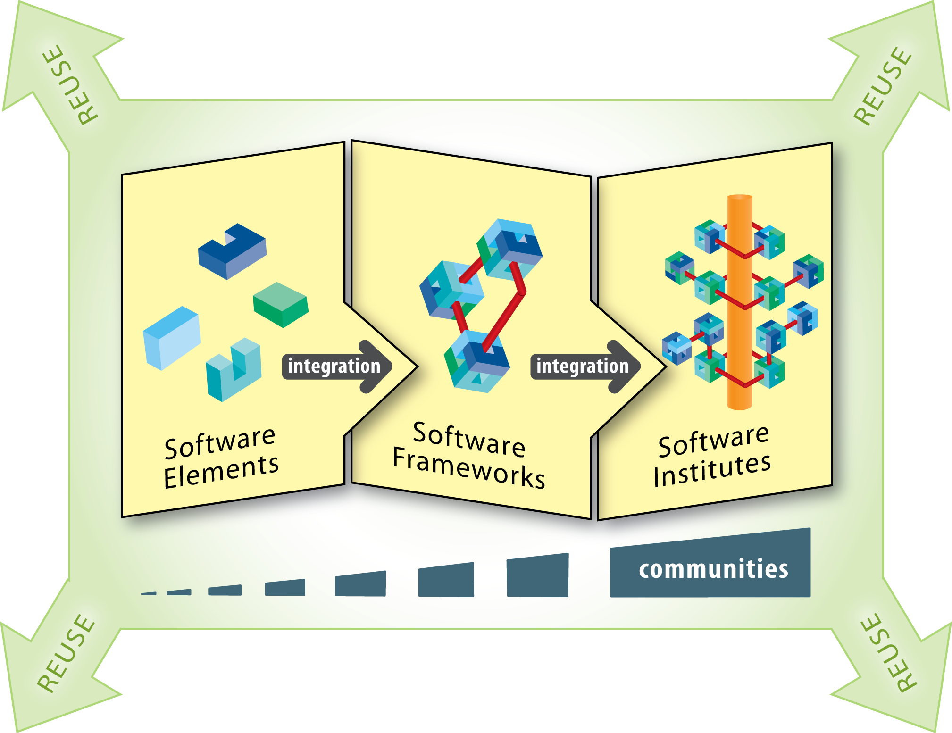
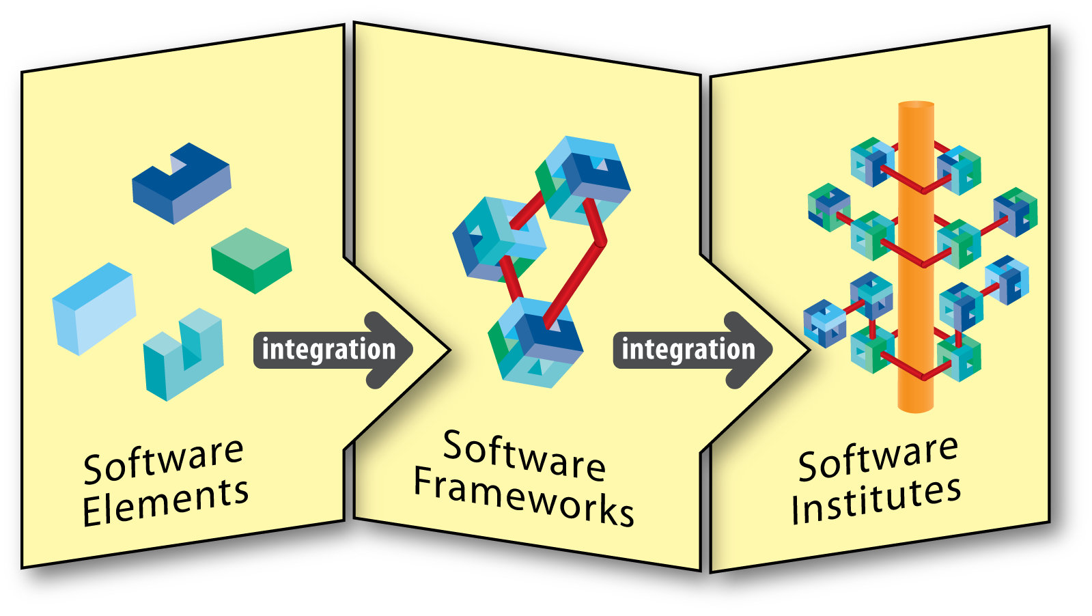
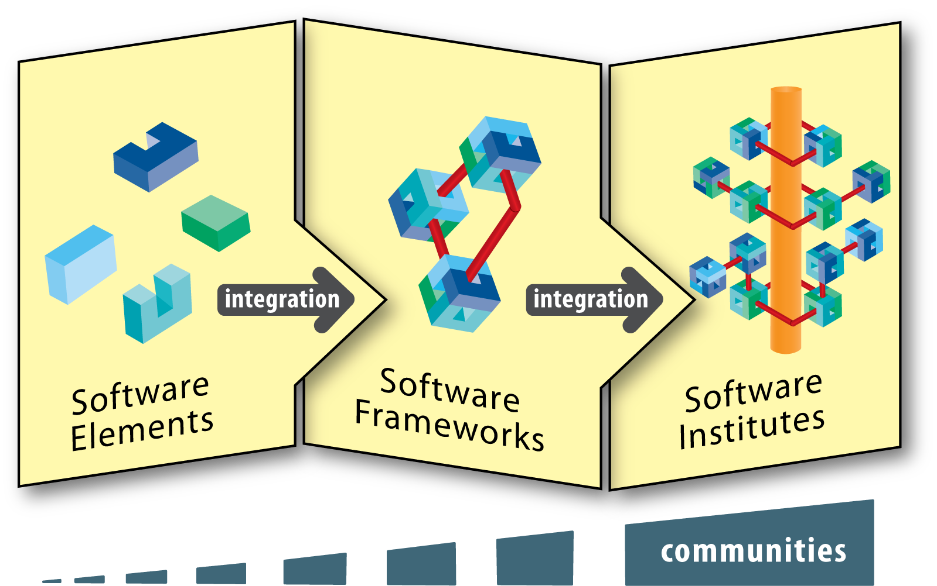
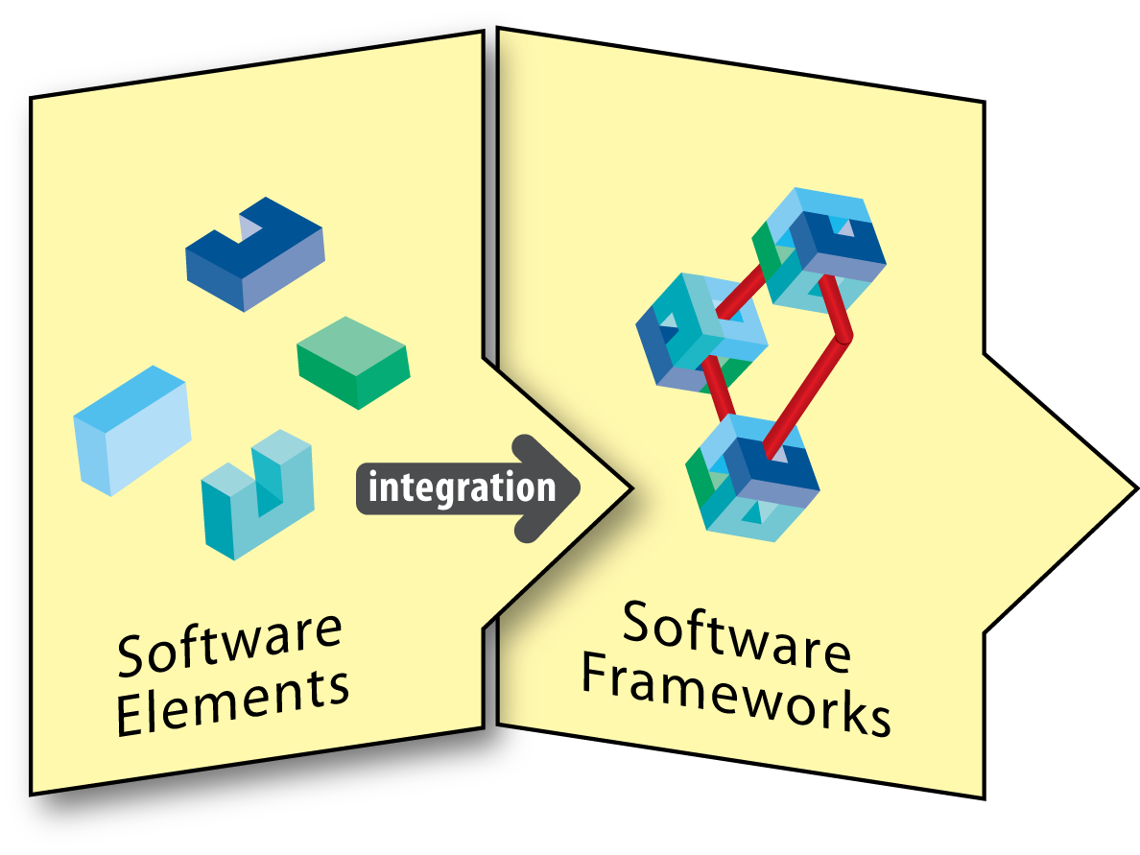
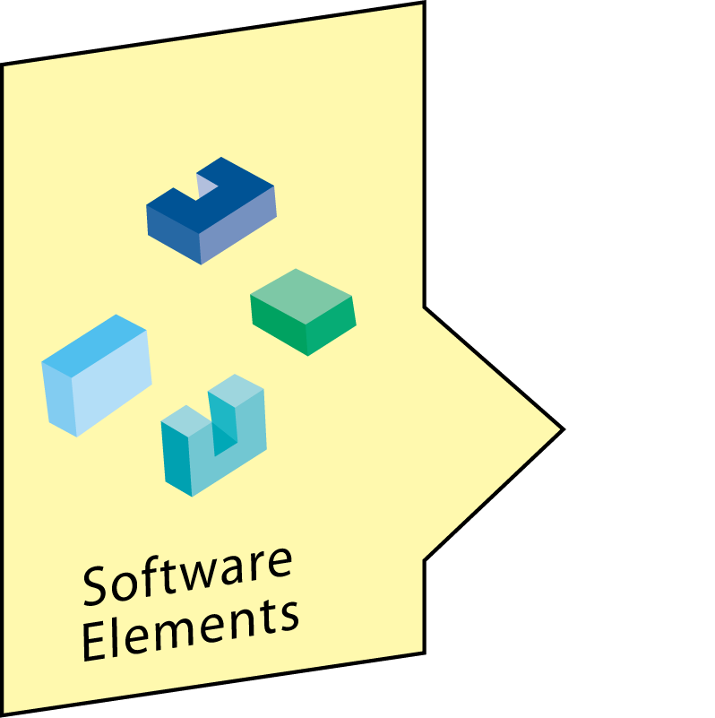
NSF Software Infrastructure Projects
5 rounds of funding, 65 SSEs
4 rounds of funding, 35 SSIs
2 rounds of funding, 14 S2I2 conceptualizations
See http://bit.ly/sw-ci for current projects
SSE & SSI – NSF 14-520: Cross-NSF, all Directorates participating
Next SSEs due Feb 2015; Next SSIs due June 2015

Slide 8
SI² Solicitation and Decision Process
Proposal reviews well -> my role becomes matchmaking
I want to find program officers with funds, and convince them that they should spend their funds on the proposal
Unidisciplinary project (e.g. bioinformatics app)
Work with single program officer, either likes the proposal or not
Multidisciplinary project (e.g., molecular dynamics)
Work with multiple program officers, ...
Omnidisciplinary project (e.g. http, math library)
Try to work with all program officers, often am told “it’s your responsibility”
To judge software, need to understand/forecast impact

Slide 9
Measuring Impact – Scenarios
Developer of open source physics simulation
Possible metrics
How many downloads? (easiest to measure, least value)
How many contributors?
How many uses?
How many papers cite it?
How many papers that cite it are cited? (hardest to measure, most value)
Developer of open source math library
Possible metrics are similar, but citations are less likely
What if users don’t download it?
It’s part of a distro
It’s pre-installed (and optimized) on an HPC system
It’s part of a cloud image
It’s a service
Future impacts – let proposers suggest

Slide 10
ACI Software Cluster Programs
In these programs, ACI works with other NSF units to support projects that lead to software as an element of infrastructure
Issue: amount of software that is infrastructure grows over time, and grows faster than NSF funding
Q: How can NSF ensure that software as infrastructure continues to appear, without funding all of it?
A: Incentives
The devil is in the details

Slide 11
Other Software Discussions
Working Towards Sustainable Software for Science: Practice and Experience (WSSSPE)
Google: WSSSPE
2 previous workshops, one upcoming
WSSSPE2 @ SC14 (Nov 16, New Orleans)
Lessons:
Many of the issues in developing sustainable software are social, not technical
Software work is inadequately visible in ways that “count” within the reputation system underlying science

Slide 12
Where We Are
To judge software, need to understand/forecast impact
Q: How can NSF ensure that software as infrastructure continues to appear, without funding all of it?
A: Incentives
Many of the issues in developing sustainable software are social, not technical
Software work is inadequately visible in ways that “count” within the reputation system underlying science
Hypothesis: better measurement of contributions can lead to rewards (incentives), leading to career paths, willingness to join communities, leading to more sustainable software

Slide 13
Moving Forward - NSF
Recent CISE/ACI & SBE/SES Dear Colleague Letter: Supporting Scientific Discovery through Norms and Practices for Software and Data Citation and Attribution (NSF 14-059, http://www.nsf.gov/pubs/2014/nsf14059/nsf14059.jsp)
Need well-developed metrics to assess the impact and quality of scientific software and data
Explore new norms and practices for software and data citation and attribution, so that data producers, software and tool developers, and data curators are credited
6 projects and 3 collaborative workshops funded

Slide 14
Moving Forward - Dan
Products (software, paper, data set) are registered
Credit map (weighted list of contributors—people, products, etc.) is an input
DOI is an output
Leads to transitive credit¹
E.g., paper 1 provides 25% credit to software A, and software A provides 10% credit to library X -> library X gets 2.5% credit for paper 1
Helps developer show: “my tools are important”
Issues:
Social: Trust in person who registers a product
Technological: How², Registration system
¹D. S. Katz, "Transitive Credit as a Means to Address Social and Technological Concerns Stemming from Citation and Attribution of Digital Products," Journal of Open Research Software, v.2(1): e20, 2014. DOI: 10.5334/jors.be
²D. S. Katz, A. M. Smith, "Implementing Transitive Credit with JSON-LD," 2nd Workshop on Sustainable Software for Science: Practice and Experiences (WSSSPE2), 2014. URL: http://arxiv.org/abs/1407.5117

Slide 15
Moving Forward - Community
Career paths – Is there a role for non-tenure-track researchers who produce software, data, etc. in universities?
Assuming yes, do universities recognize and support this? If not, how to get them to?
What is needed to support reproducibility of science, in terms of data and software?
Lots of entities with similar interests in both software and data, e.g. JISC, RCUK, NIH, DOE, Sloan & Moore, Mozilla, Apache, etc.
Participate in WSSSPE
Other ideas and questions are welcome, now or later
dkatz@nsf.gov or d.katz@ieee.org

Slide 16
Resources
NSF Software as Infrastructure Vision: http://www.nsf.gov/publications/pub_summ.jsp?ods_key=nsf12113
Implementation of NSF Software Vision: http://www.nsf.gov/funding/pgm_summ.jsp?pims_id=504817
Software Infrastructure for Sustained Innovation (SI2) Program
Scientific Software Elements (SSE) & Scientific Software Integration (SSI) solicitation: http://www.nsf.gov/publications/pub_summ.jsp?ods_key=nsf14520
2013 PI meeting: https://sites.google.com/site/si2pimeeting/
2014 PI meeting: https://sites.google.com/site/si2pimeeting2014/
Awards: http://bit.ly/sw-ci
Working towards Sustainable Software for Science: Practice and Experiences (WSSSPE)
Home: http://wssspe.researchcomputing.org.uk (includes links to all slides & papers)
1st workshop paper: http://arxiv.org/abs/1404.7414
2nd workshop site: http://wssspe.researchcomputing.org.uk/wssspe2/
NSF 14-059: “Dear Colleague Letter - Supporting Scientific Discovery through Norms and Practices for Software and Data Citation and Attribution”
http://www.nsf.gov/pubs/2014/nsf14059/nsf14059.jsp
Transitive Credit Papers
http://dx.doi.org/10.5334/jors.be
http://arxiv.org/abs/1407.5117

Slide 17
Credits:
SI2 Program:
Current program officers: Daniel S. Katz, Rudolf Eigenmann, William Y. B. Chang, John C. Cherniavsky, Almadena Y. Chtchelkanova, Cheryl L. Eavey, Evelyn Goldfield, Sol Greenspan, Daryl W. Hess, Peter H. McCartney, Bogdan Mihaila, Dimitrios V. Papavassiliou, Andrew D. Pollington, Barbara Ransom, Thomas Russell, Massimo Ruzzene, Nigel A. Sharp, Paul Werbos, Eva Zanzerkia
Formerly-involved program officers: Manish Parashar, Gabrielle Allen, Sumanta Acharya, Eduardo Misawa, Jean Cottam-Allen, Thomas Siegmund
WSSSPE:
Organizers: Daniel S. Katz, Gabrielle Allen, Neil Chue Hong, Karen Cranston, Manish Parashar, David Proctor, Matthew Turk, Colin C. Venters, Nancy Wilkins-Diehr
WSSSPE1 Summary paper authors: Daniel S. Katz, Sou-Cheng T. Choi, Hilmar Lapp, Ketan Maheshwari, Frank Löffler, Matthew Turk, Marcus D. Hanwell, Nancy Wilkins-Diehr, James Hetherington, James Howison, Shel Swenson, Gabrielle D. Allen, Anne C. Elster, Bruce Berriman, Colin Venters
WSSSPE1 Keynote speakers: Phil Bourne, Arfon Smith

